Slide 1

Udemy Courses
EDA
This dataset contains 3.682 records of courses.
Udemy is a massive online open course (MOOC) platform that offers both free and paid courses.
Aishah Alanazi

Slide 2
Objective :
methodology
Findings
conclusion

Slide 3
methodology
findings and lnsights
Data preparation
Problem understanding
Exploratory Data

Slide 4

Problem understanding
In this project I plan to understand more about Alot of udemy instructors use digital marketing to market for their courses , they need to know more about the courses un the udemy , does the course time affect the price or the subscribers count , does the price related to course duration and does the course duration affect the subscribers count !? Using the dataset of udemy courses i have from kaggle i plan to answer those questions using an EDA on the dataset.

Slide 5
Dataset
Rows
Columns
Dataset
3678
11

Slide 6



Data preparation
Data preparation
Update unconsistent
Data
delete unneccassery Column
Convert column
type
Deal with null values

Slide 7

Findings

Slide 8
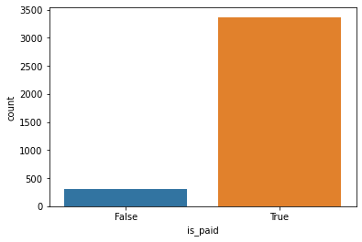
Most of the course are paid
Udemy Courses
01

Slide 9
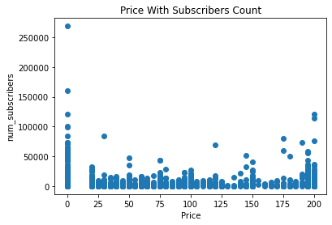
price does not affect on the subscribers count.
Udemy Courses
02

Slide 10
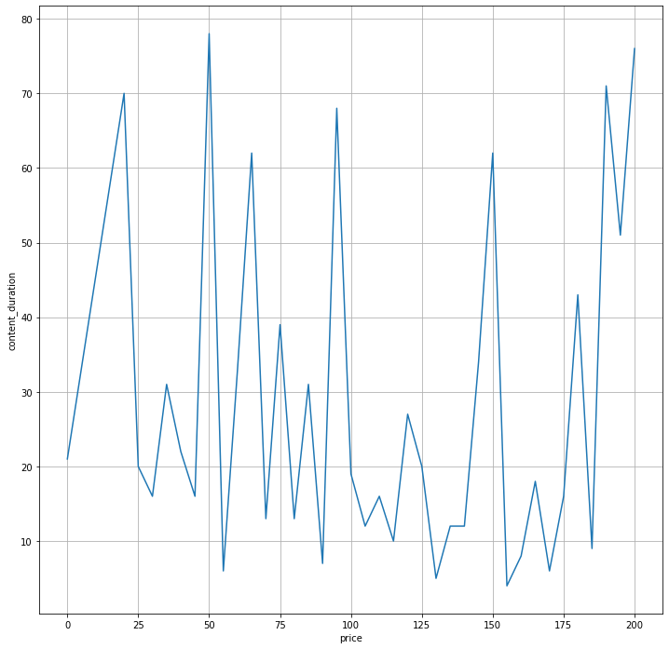
the course duration not affect the price
Udemy Courses
03

Slide 11
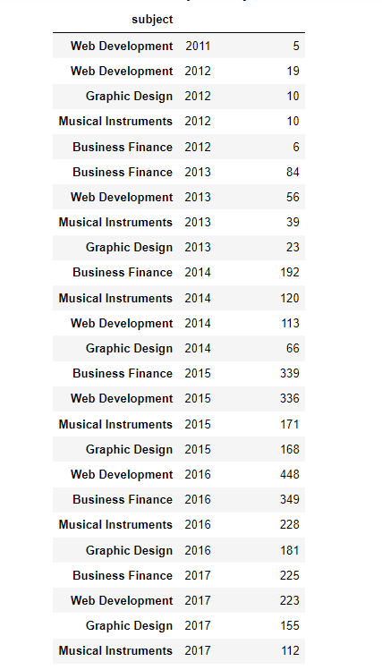
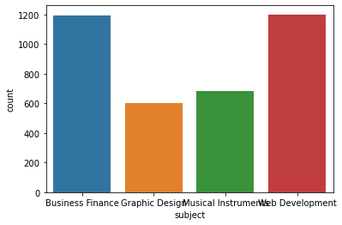
Udemy Courses
Topics of the courses in the years
04

Slide 12
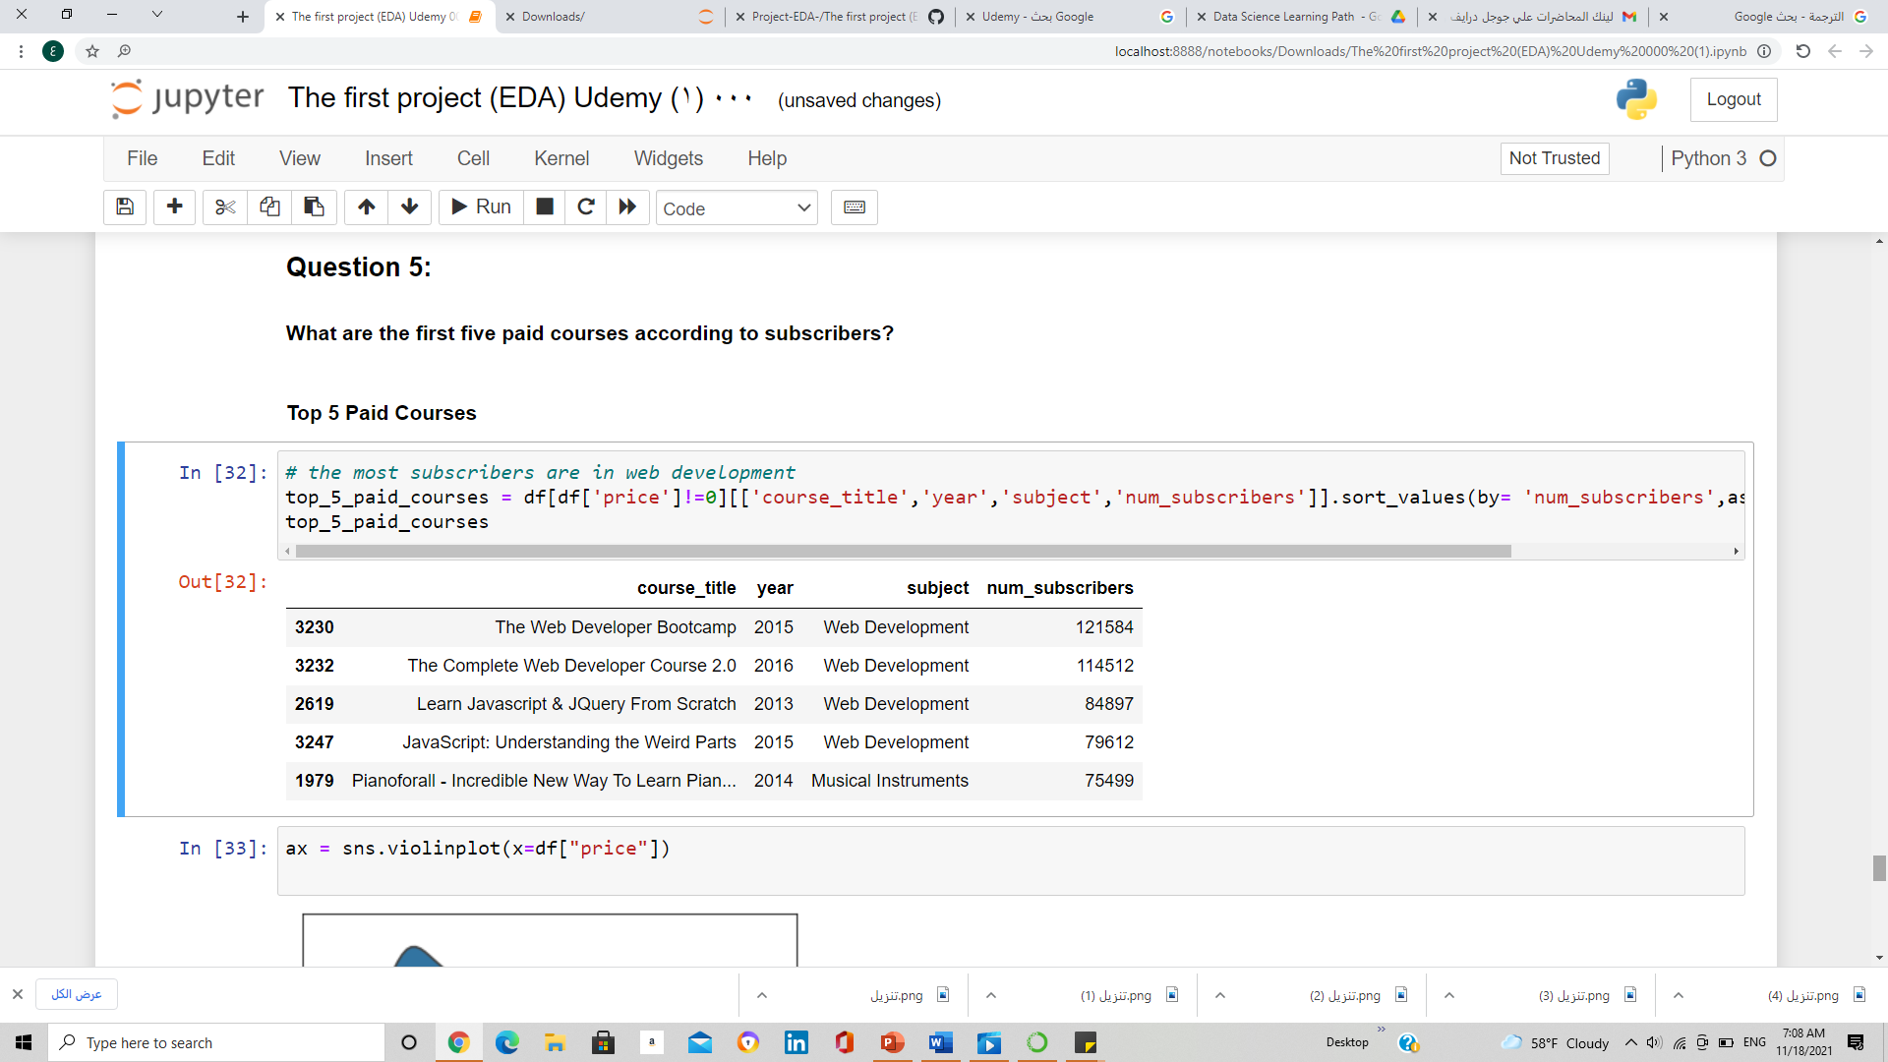
first five paid courses according to subscribers
Udemy Courses
05

Slide 13
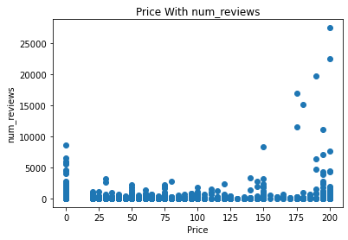
The more the subscriber pays, the more comments
Udemy Courses
06

Slide 14
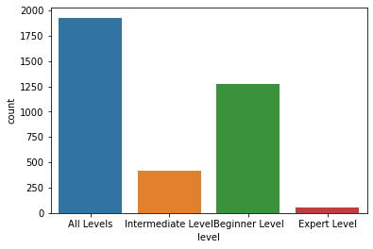
most of the course sare all levels and Begginer Level To Get More Students
Udemy Courses
07

Slide 15
خاتمة
Thank You

